Slide 1
Orleans 4.0
Back to Basics
Orleans Virtual Meetup 16

Slide 2
Orleans 2.0 to 3.x
Distributed ACID transactions – used in production @ MS
New scheduler – 30% throughput boost
New Code Generator – Roslyn source code analysis
Refactored cluster membership – faster recovery
New networking layer (Bedrock) – faster, TLS support
Direct client – can call grains from any thread, just need IGrainFactory
Generic HostBuilder support – easy co-hosting with ASP.NET, etc

Slide 3
4.0 Thoughts
Revisited grain id – simple, stringly, open
Pluggable grain directory
POCO grains
Bedrock Framework – collaboration with ASP.NET team
“Orleans Core”
Improved Distributed Tracing
Improved Kubernetes experience
<Your Feature Here>
<Your Feature Here>

Slide 4
in-memory, persisted, or stateless
User/fabio
grain = identity + behavior [+ state]
class User : Grain, IUser

Slide 5
Grain Identity – Current
Conceptually: type + key
Type = hash(ClassName) or manually specified via attribute
Key = one of:
Guid
Int64
String
Guid + String
Int64 + String
Also includes the kind of grain (SystemTarget, Grain, Client, more)

Slide 6
Trouble with the current GrainId
Not human readable
Key type is not encoded into id – 128 opaque bits + optional string
Troublesome for call filters, extension libraries, etc.
Generic type arguments are not part of GrainId
3 bytes of hash of generic arguments are encoded into id
Full type args are stored in GrainReference - this adds corner cases
∴ GrainId alone is not sufficient to construct a grain
Coupling between implementation class & grain identity

Slide 7
New GrainId – WIP
Type + Key
Both UTF8 strings
Both user-defined, eg “user/terry”
Existing grain ids can be encoded to & from new GrainId
Open, straight-forward to serialize/deserialize
Resolver/Formatter interface: convert GrainId Type ↔ .NET Type
Extensible – can allow custom generic type arg encoding, for example
Under development

Slide 8
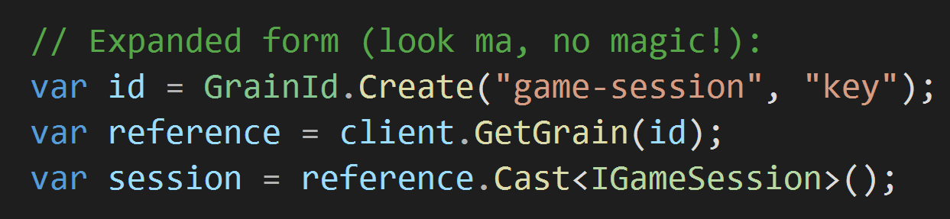
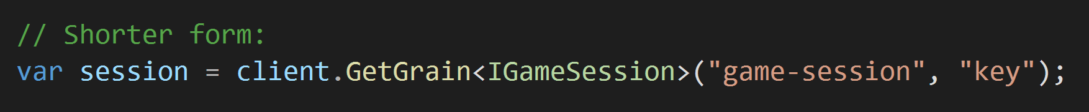
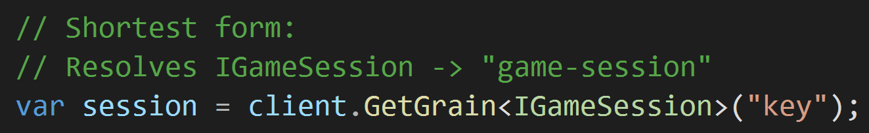
New GrainId

Slide 9
Supporting legacy ids
If using existing grain base interfaces (IGrainWith*Key) – no change
Resolvers will continue to resolve your grain to a legacy-style id
Eg: sys.grain.<TypeCode>/<N0><N1>[+<KeyExt>]
Not as human readable (unless…)

Slide 10
Grain Directory – Current
Conceptually: lookup table for mapping from GrainId -> Silo
Distributed, range-based partitioning, in-memory
Pros
Built-in – no external dependencies, no configuration
Battle tested
Eventually consistent
Cons
Sensitive to cluster changes
Not customizable
Eventually consistent

Slide 11
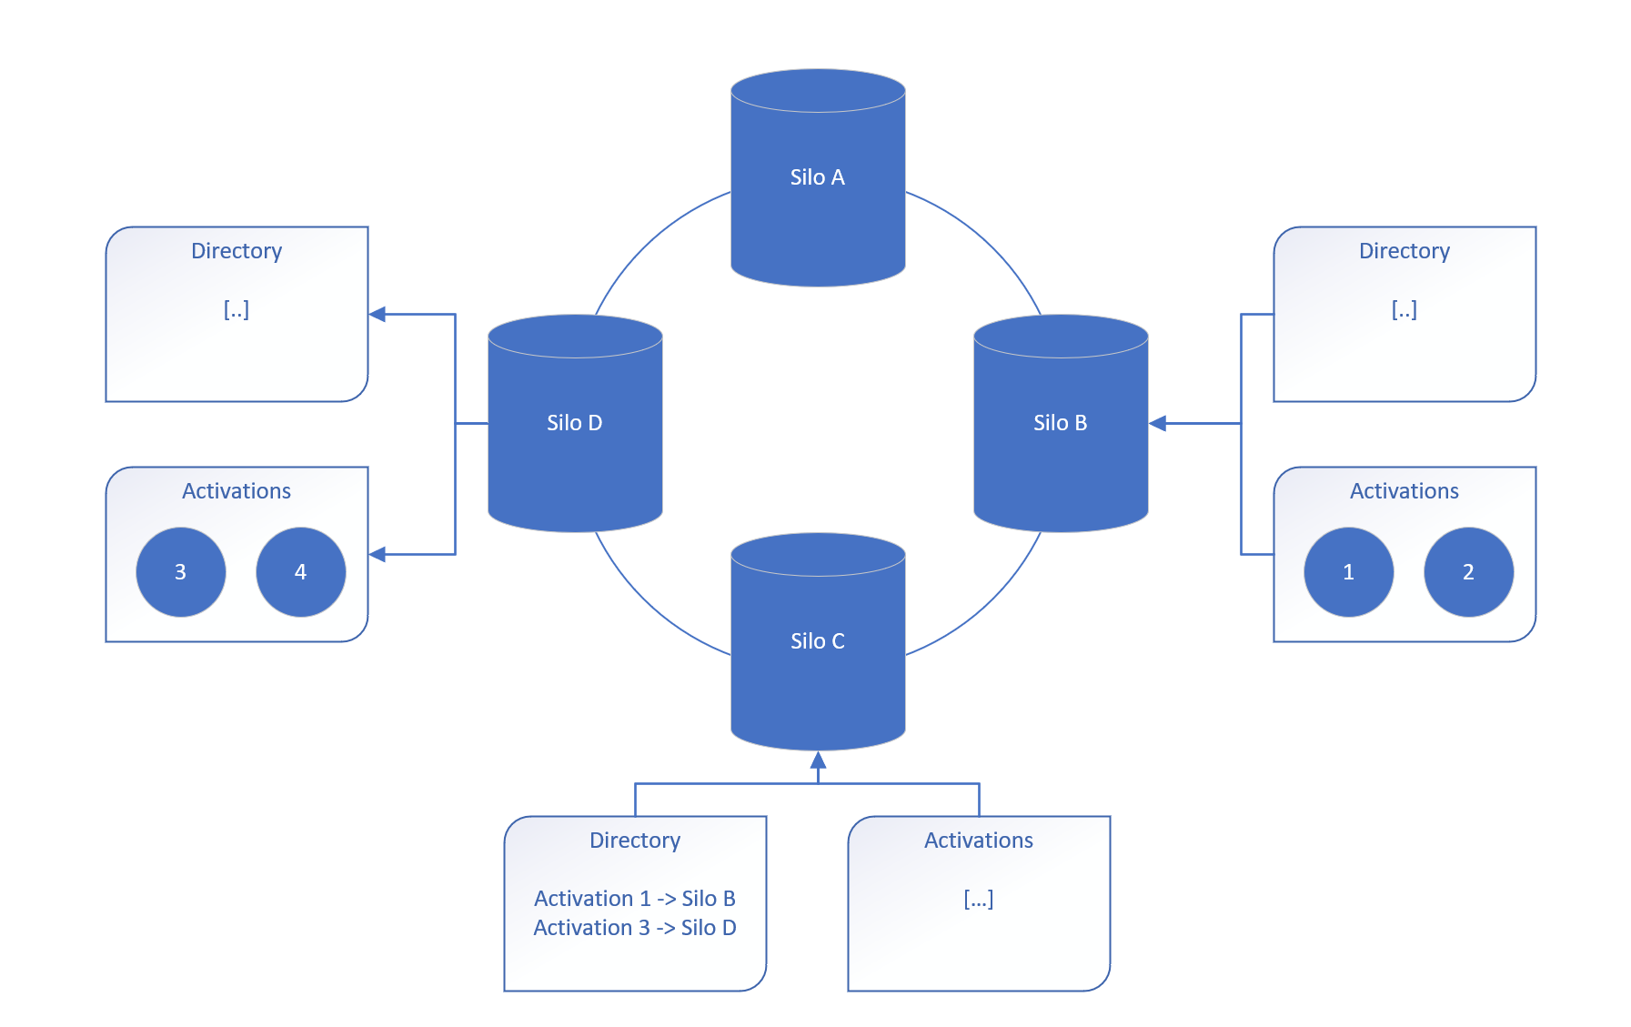

Slide 12
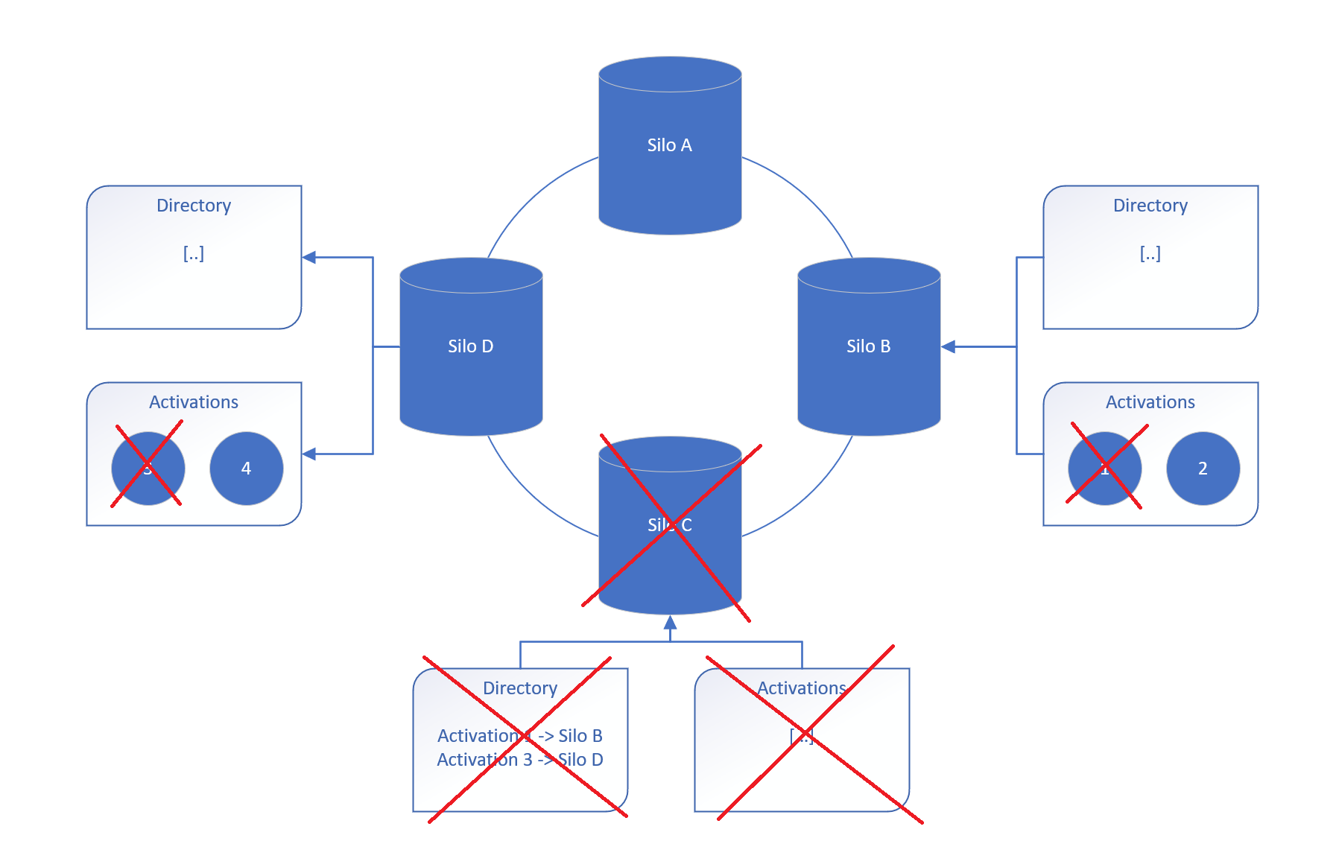

Slide 13
Grain Directory - Pluggable
Customizable
Can add custom implementations
Configured via dependency injection
Can be specified per grain type
Implementation examples
Storage based
Consensus based
Consistent hashing
Etc.

Slide 14
4.0 Thoughts
Revisited grain id – simple, stringly, open
Pluggable grain directory
POCO grains
Bedrock Framework – collaboration with ASP.NET team
“Orleans Core”
Improved Distributed Tracing
Improved Kubernetes experience
<Your Feature Here>
<Your Feature Here>

